Slide 1
CAR 163916461 (Observation)

Slide 2
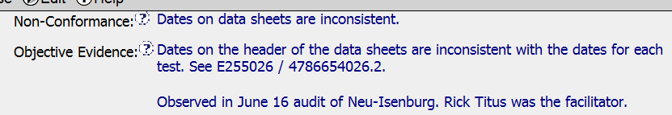
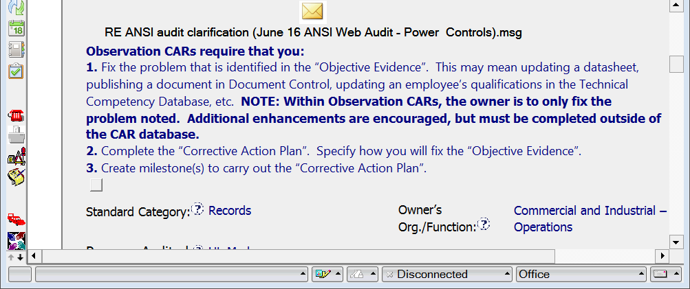
CAR 163916461 Observation
Problem statement
Helpful info & guidance for CAR owner
☺

Slide 3
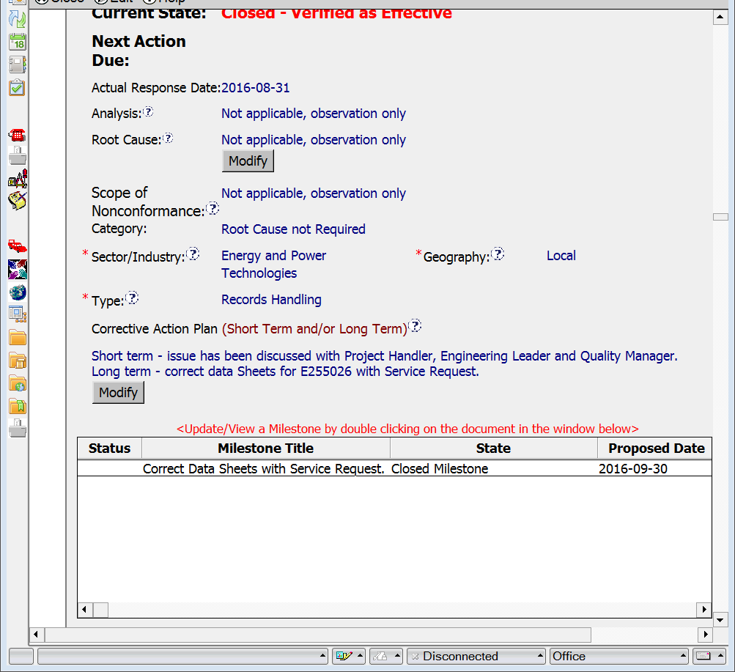
CAR 163916461 Observation
NOTE: now required per updated definition (for new CARs as of Oct 1), but not at time of CAR
Nice two-part response ☺
Reason for almost 2 months to fix was in attached email (ANSI did not complete until Aug 19) - a comment in CAR would’ve been helpful

Slide 4
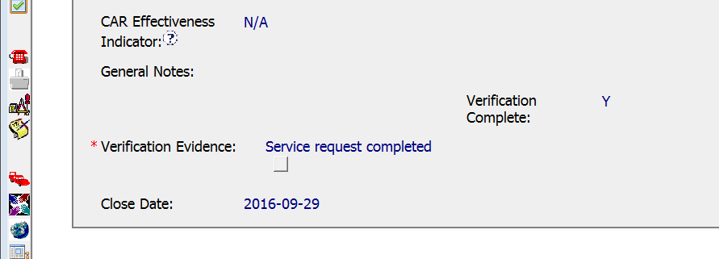
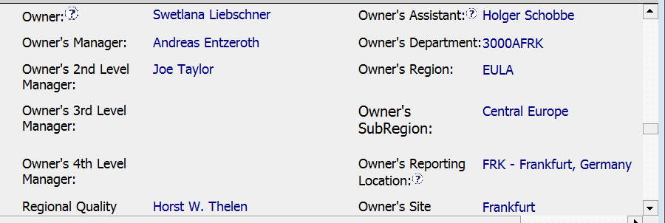
CAR 163916461 Observation
Closed within 2 days of the correction☺
Why was Jeffery Smidt removed from escalation path?

Slide 5
CAR 163916461 Observation
CBS Requirements | Excellent | Moderate | Need Improve | N/A
(C) Extensions are within requirement (<30 days, 3 or less) |  |  |  | √
(T) Most appropriate ‘category’, ‘type’, ‘geography’ are selected | √
(P) Facilitates the handling of disputed CARs |  |  |  | √
(T) Acts on CARs within required timeframe | √
(C) Analysis shows clear path to root cause and scope; stakeholders identified |  |  |  | √
(C) Root cause statement is succinct, reasonable, complete |  |  |  | √
(C) Corrective actions fix the objective evidence and other problems found; address entire root cause and scope. For observations, they do not go beyond fixing the objective evidence | √
(C) Milestones address containment & owner’s verification; completed per milestone expectations | √
(P) Verification per requirements | √
(L) Referenced communications are attached as needed | √
(C L) Evidence of communication for overdue/escalated CARs and other pertinent concerns |  |  |  | √
(P) Trains other CAR Champions |  |  |  | √

